Slide 1
Ekman Theory …and vertical advection in the ocean
COASTAL UPWELLING and DOWNWELLING

Slide 2
Notes:
12

Slide 3
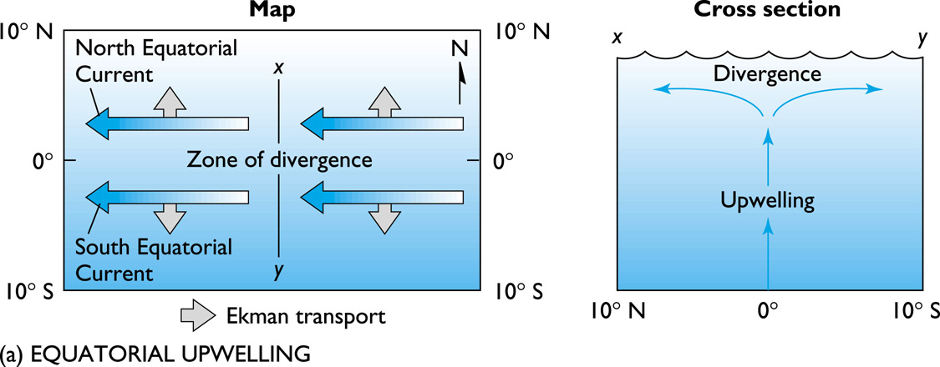

Slide 4
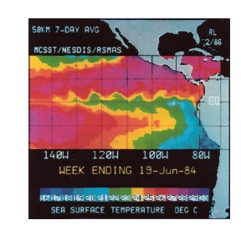

Slide 5
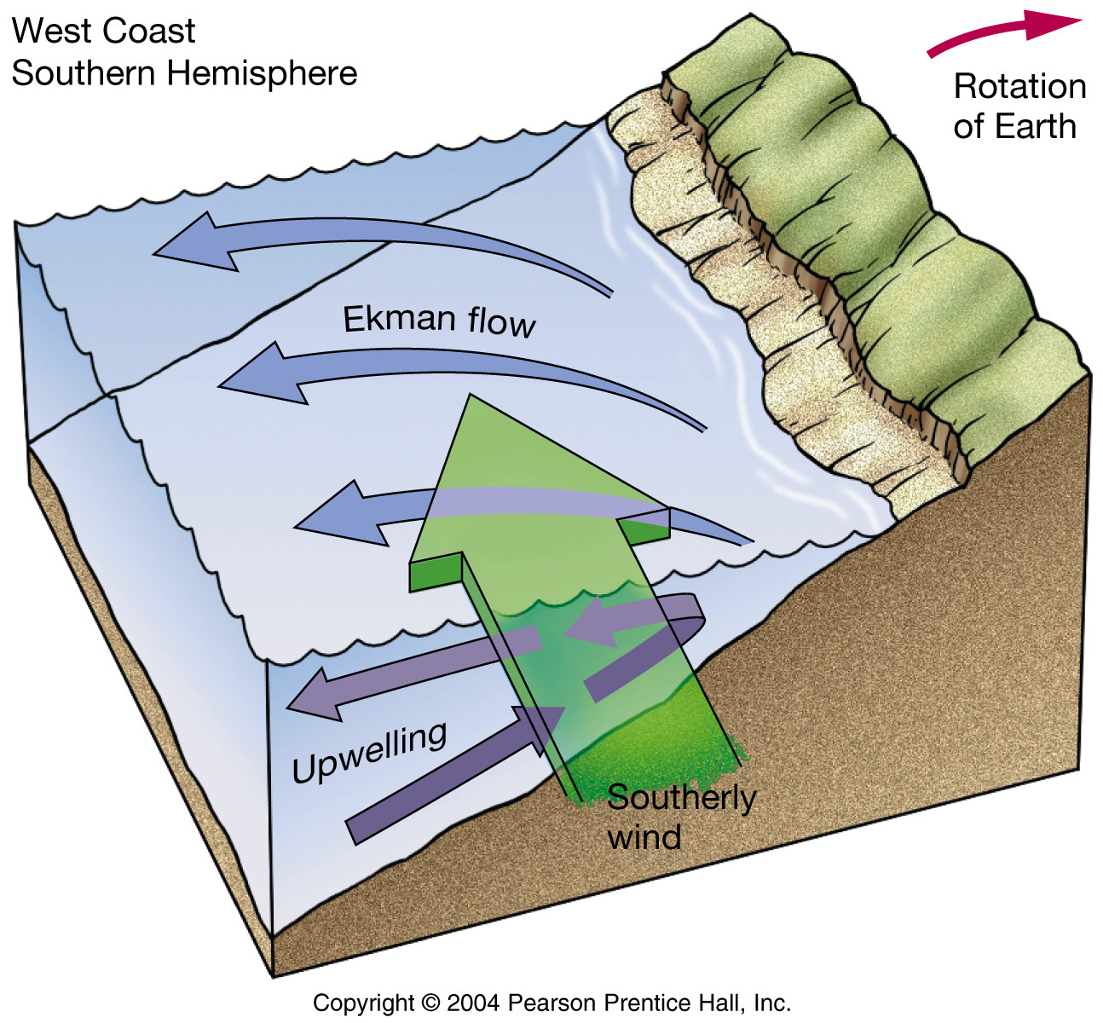

Slide 6
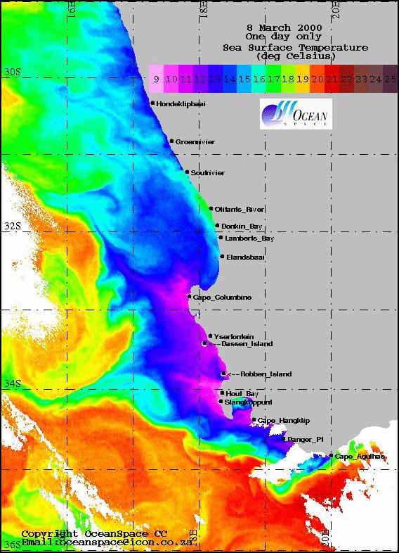
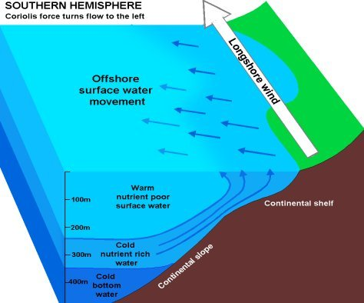
Daily sea surface temperature off Cape Town in summer
Coastal Upwelling

Slide 7
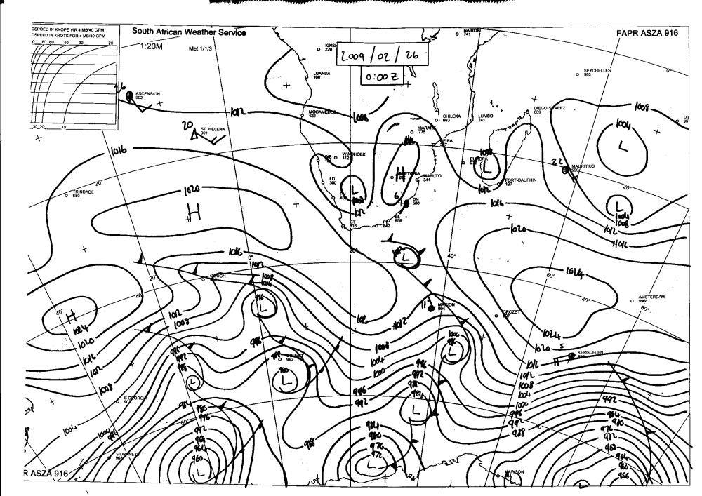
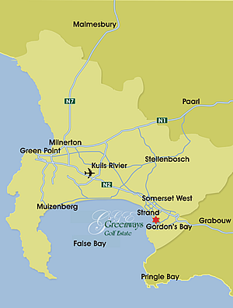
SE wind

Slide 8
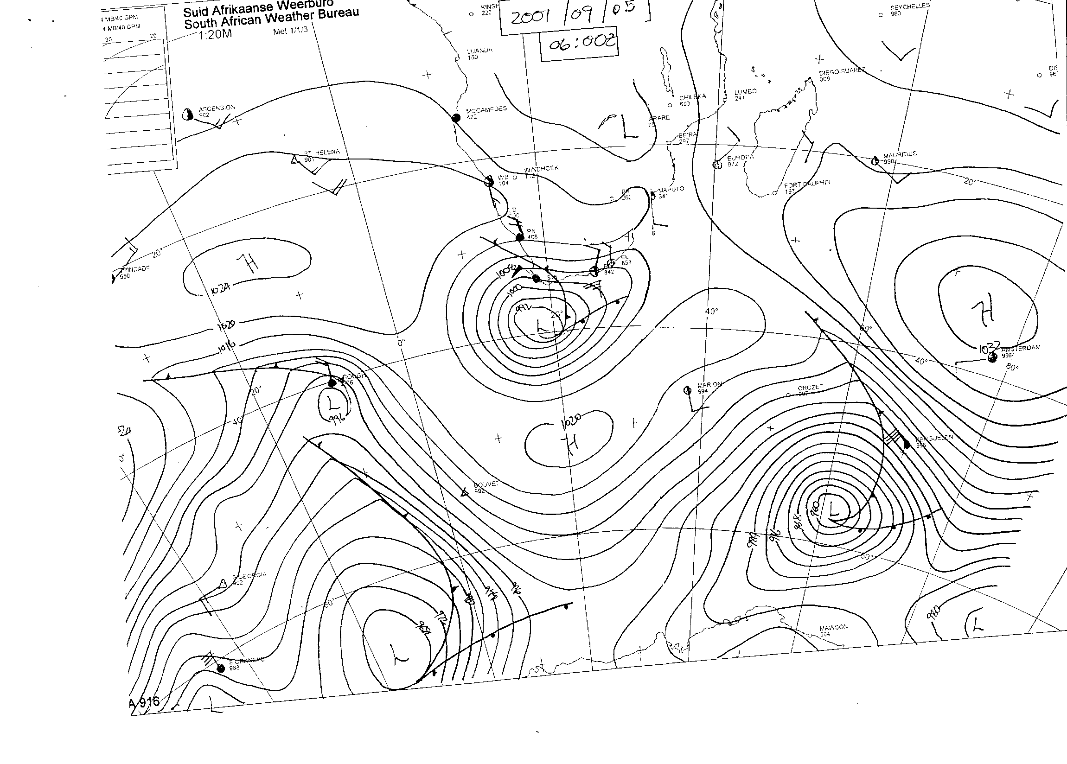
NW wind

Slide 9
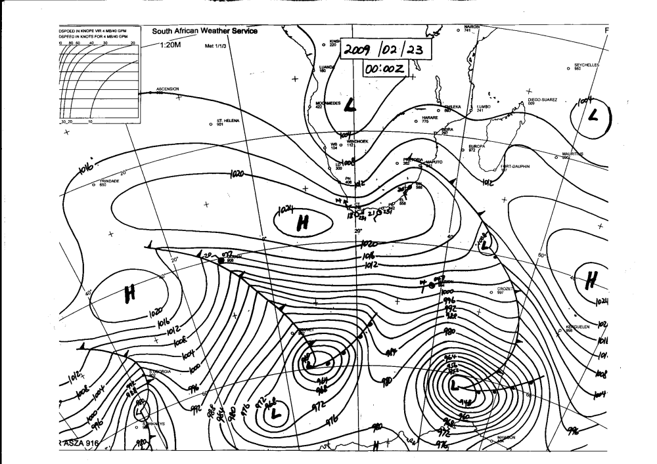
SE wind

Slide 10
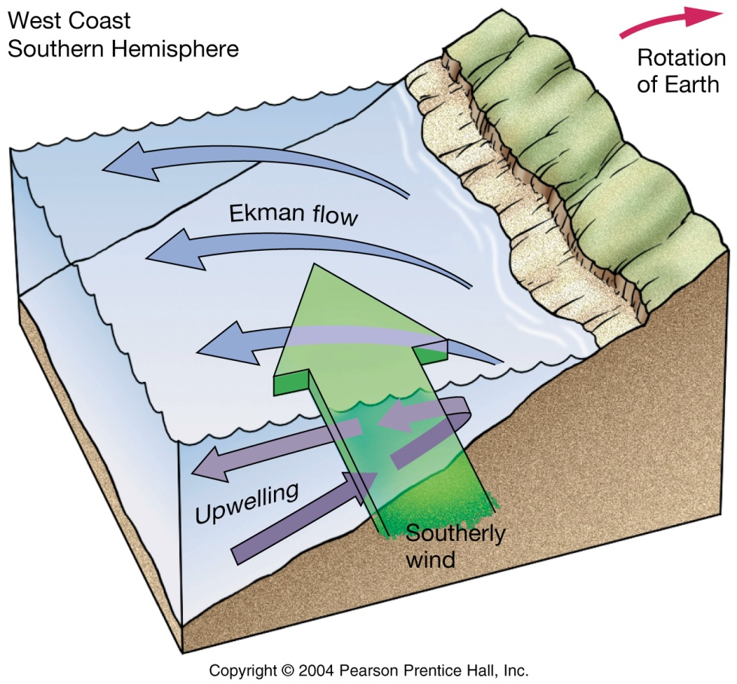
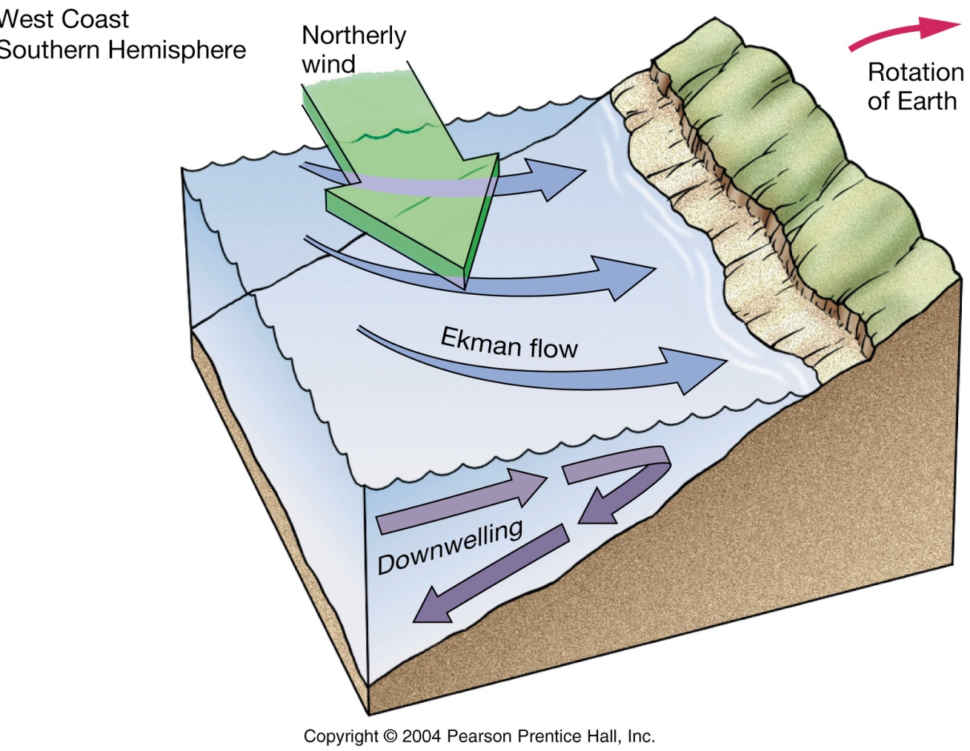

Slide 11
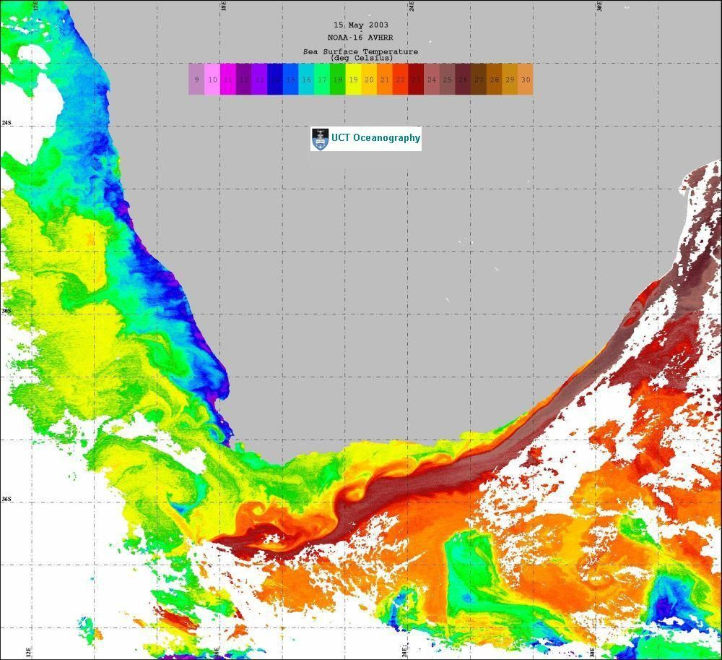
East meets West
False-colour thermal infrared image portraying sea surface temperature of marine environment around southern Africa (Source: NOAA-16)

Slide 12
Notes:
12

Slide 13
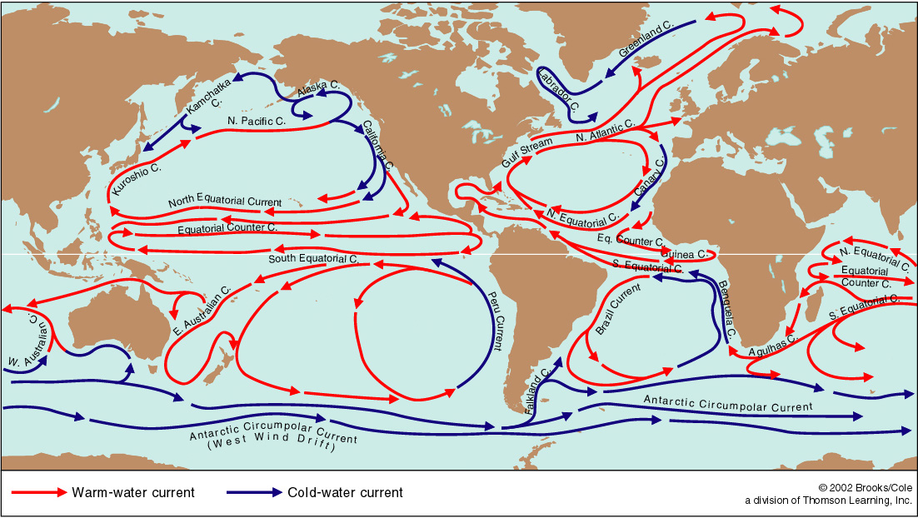
Eastern vs Western Boundary currents

Slide 14
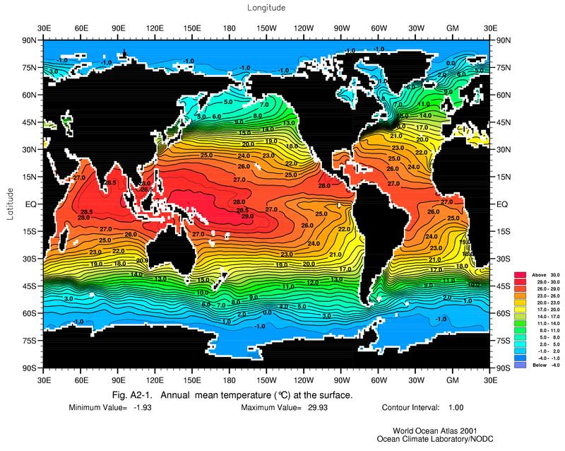
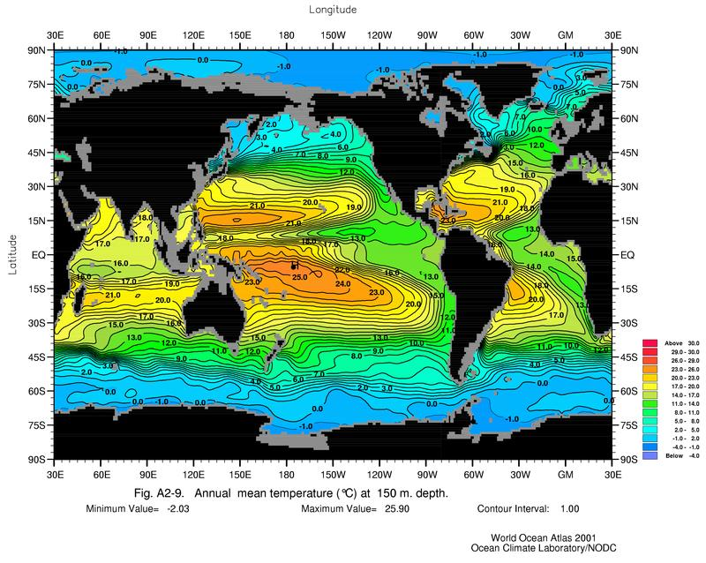
Temperature
Surface
150 meter depth

Slide 15
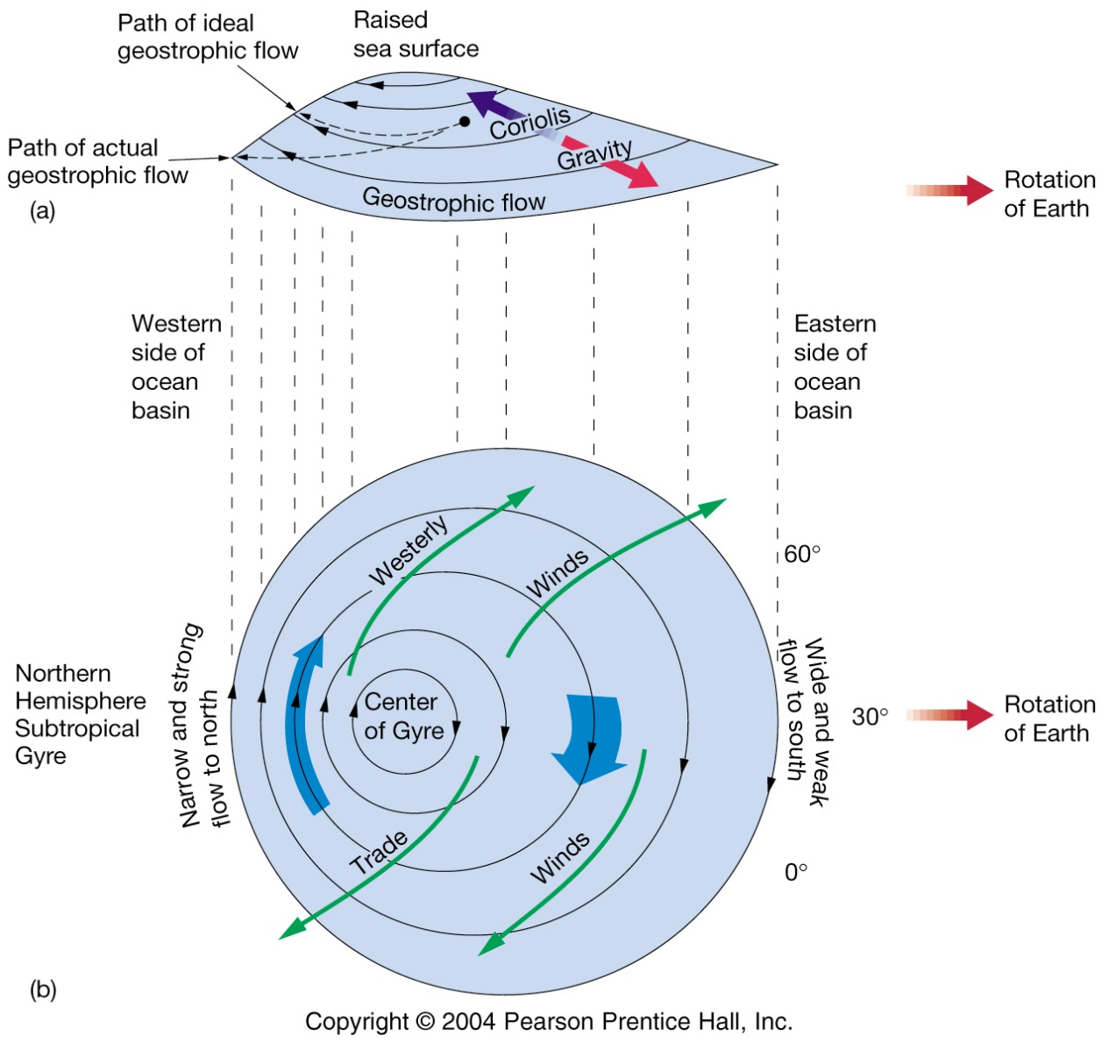
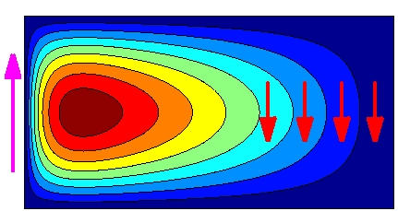
What is meant by the term eastern or western boundary current?
W
E

Slide 16
Sea surface height

Slide 17
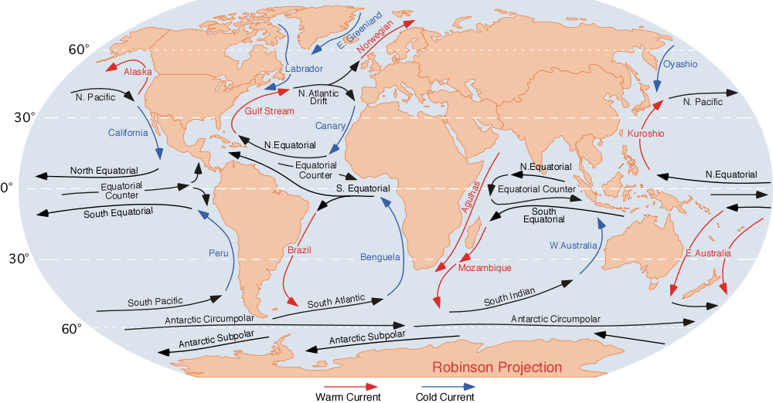
Eastern Boundary Currents
Canary (N Atlantic)
Benguela (S Atlantic)
California (N Pacific)
Peru (S Pacific)

Slide 18
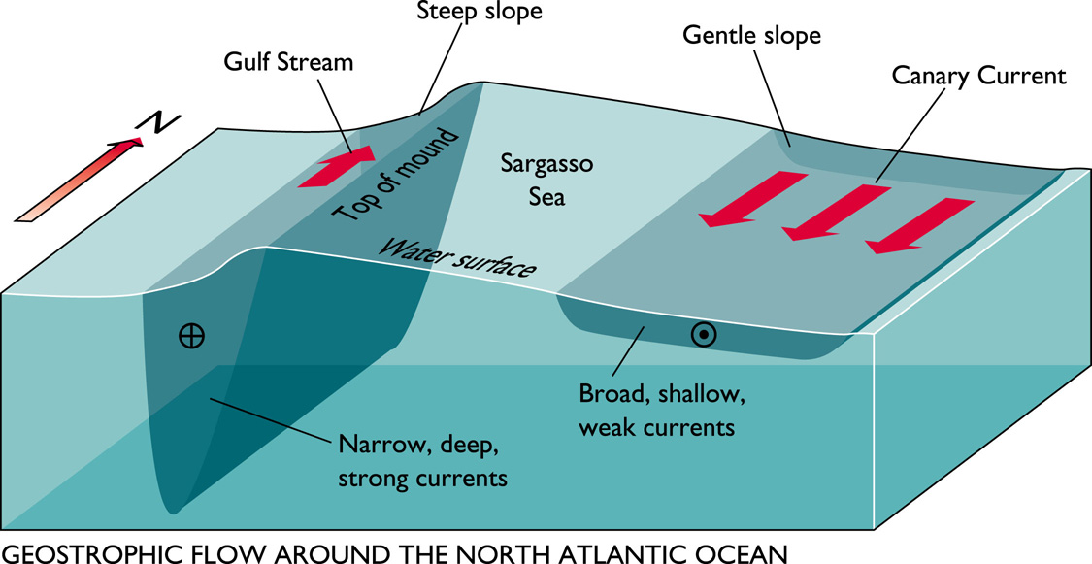

Slide 19
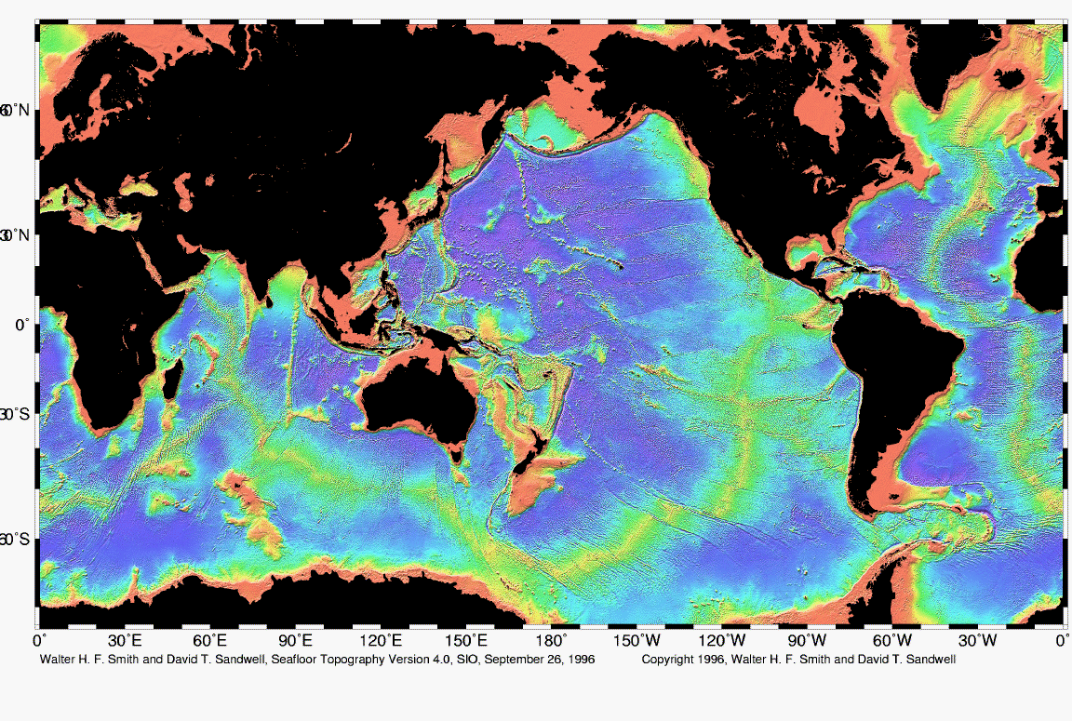
Eastern boundary currents are characterized by:
narrow continental shelves,

Slide 20
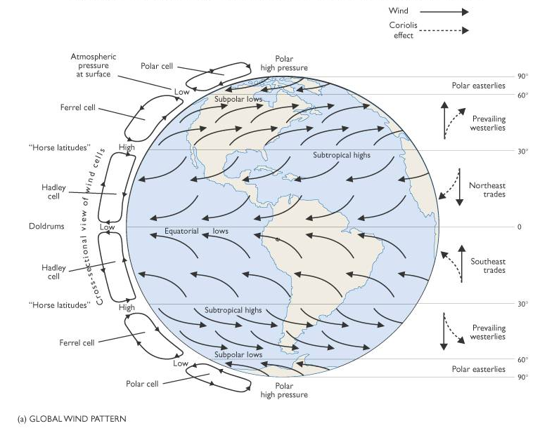
Eastern boundary currents are characterized by:
equatorward wind stress,

Slide 21
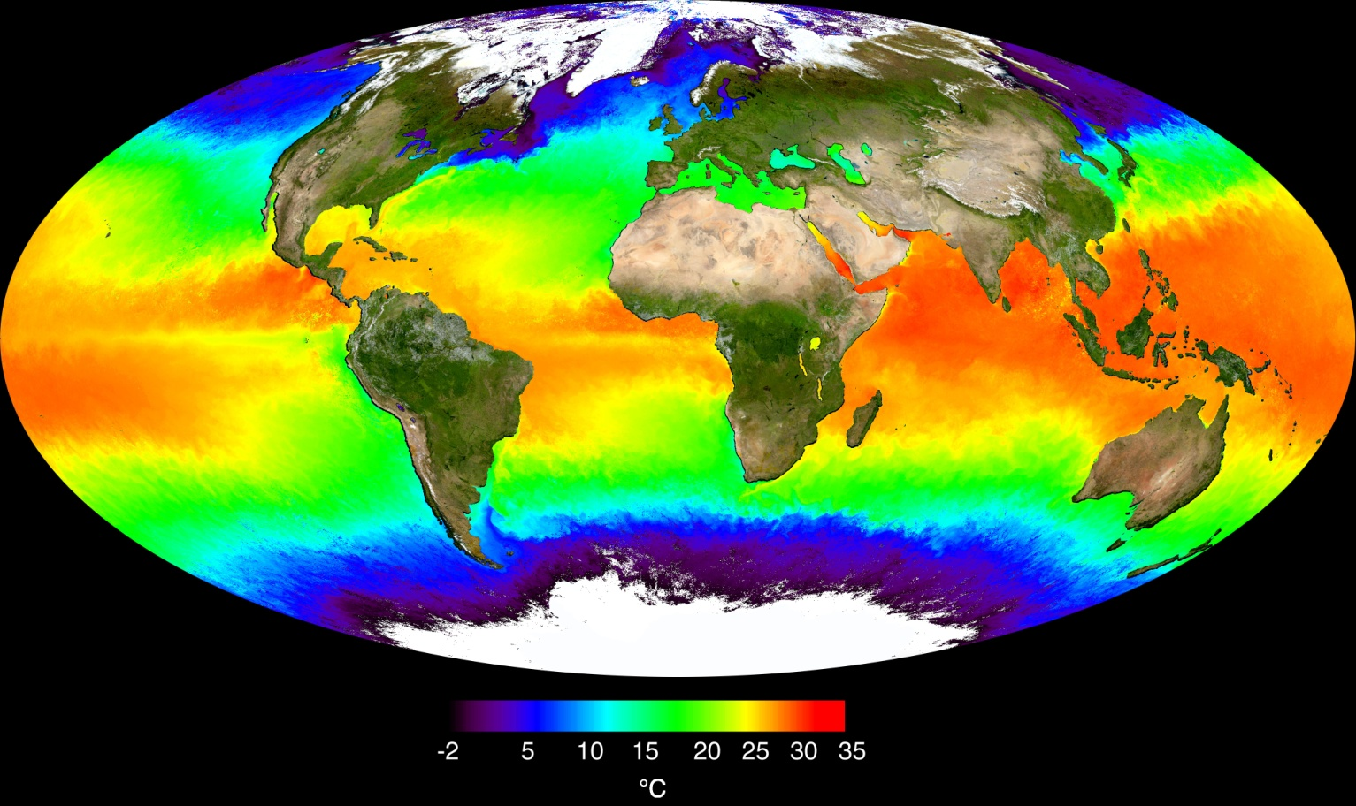
Eastern boundary currents are characterized by:
coastal upwelling,

Slide 22
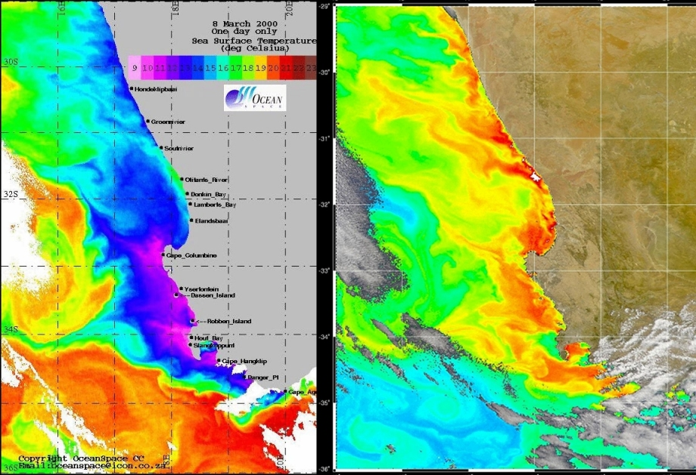
Eastern boundary currents are characterized by:
cool, highly productive coastal waters.

Slide 24
Western Boundary Currents

Slide 25
The current flow pattern in gyres is asymmetrical with narrow, deep and swift currents along the basin’s western edge and broad, shallow slower currents along the basin’s eastern edge.
This deflection is called
WESTERN INTENSIFICATION

Slide 26
The geostrophic mound is deflected to the western part of the ocean basin because of the eastward rotation of the Earth on its axis –
THIS IS CALLED WESTERN INTENSIFICATION.

Slide 27
Western Boundary Currents
Flow in the gyres is intensified along the western boundary-- narrow and fast current.
Has to do with the fact that the earth is rotating.
EXAMPLES -
Gulf Stream (in the North Atlantic)
Kuroshio Current (in the North Pacific)
Brazil Current (in the South Atlantic)
Eastern Australian Current (in the South Pacific)
Agulhas Current (in the Indian Ocean)

Slide 28
Western Boundary Currents

Slide 29
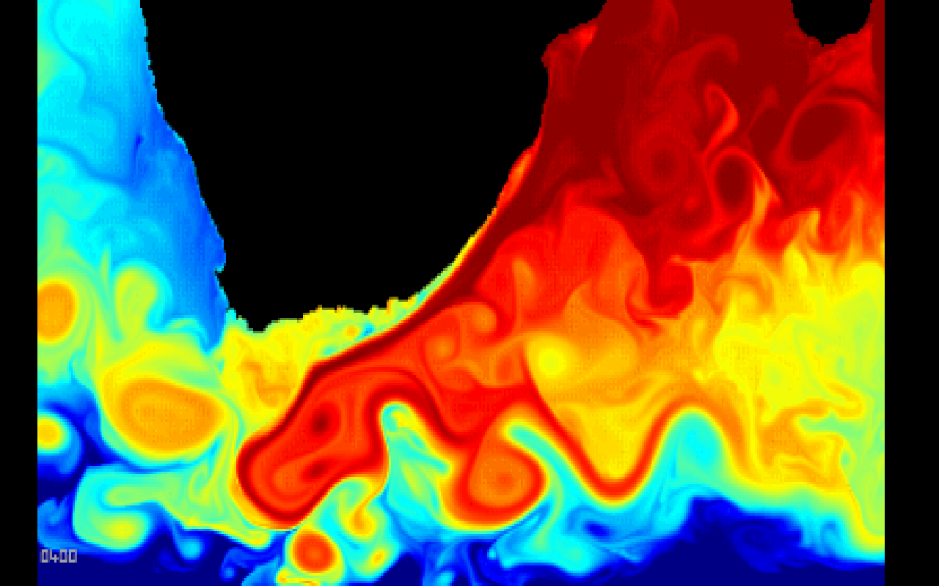
Western boundary currents, which are narrow, deep-reaching, and fast-flowing currents, not unlike jet streams associated with current instability and eddy shedding;

Slide 30
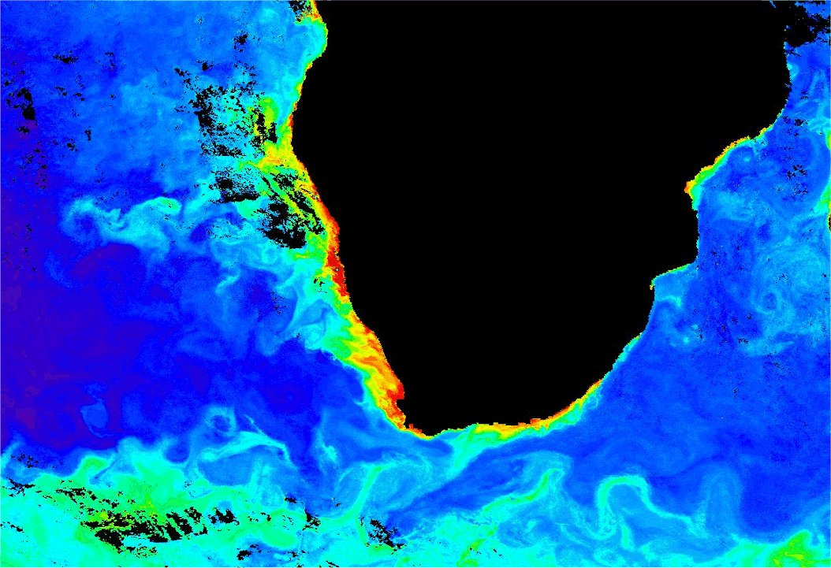
Western boundary currents poor in nutrients and general productivity.
Modis 8-day composite of Chlorophyll-a concentration for
2-10 February 2004

Slide 31
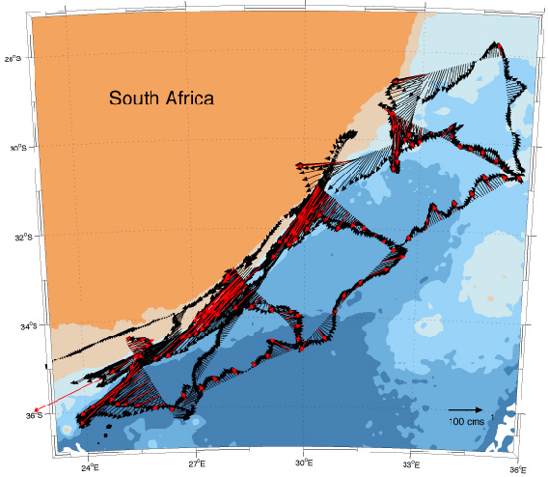
Western boundary currents typical widths of 100 km and typical speeds of 2 m s⁻¹ and causes them to shed eddies frequently.

Slide 32
Western boundary currents are atmospheric heat sinks if they move cold water toward the equator, which occurs in the subpolar gyres, and atmospheric heat sources where they move tropical water into temperate regions, as in the subtropical gyres.

Slide 33
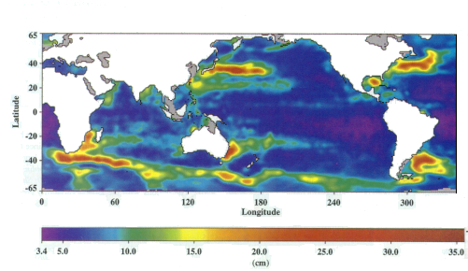
Sea Surface Height – see the effects of western boundary currents as
high areas!!

Slide 34
East meets West
False-colour thermal infrared image portraying sea surface temperature of marine environment around southern Africa (Source: NOAA-16)

